Slide 1

Flyweight Design Pattern

Slide 2
Flyweight Design Pattern
Flyweight pattern is a structural design pattern, primarily used to reduce the number of objects created.
Flyweight pattern tries to reuse already existing similar kind objects by storing them and creates new object when no matching object is found.
Flyweight pattern is used when we need to create a large number of similar objects.

Slide 3
Intent
“Use Sharing to support large numbers of fine-grained objects efficiently.”
Simply put, a method for storing a small number of complex objects that are used repeatedly

Slide 4
Keywords
Flyweight
A shared object that can be used in multiple contexts simultaneously.
Intrinsic
State information that is independent of the flyweights context. Shareable Information.
Extrinsic
State information that depends on the context of the flyweight and cannot be shared.

Slide 5
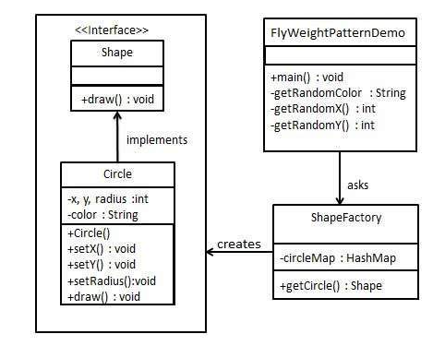
Example

Slide 6
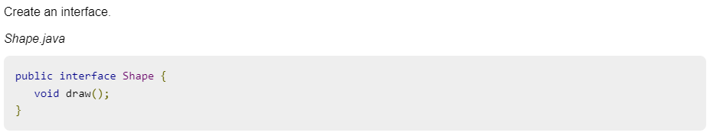
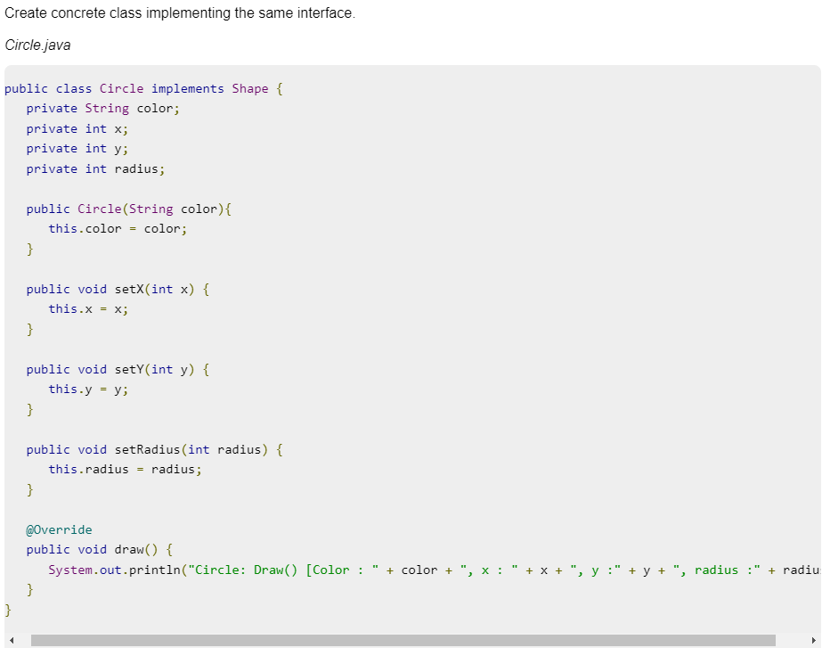

Slide 7
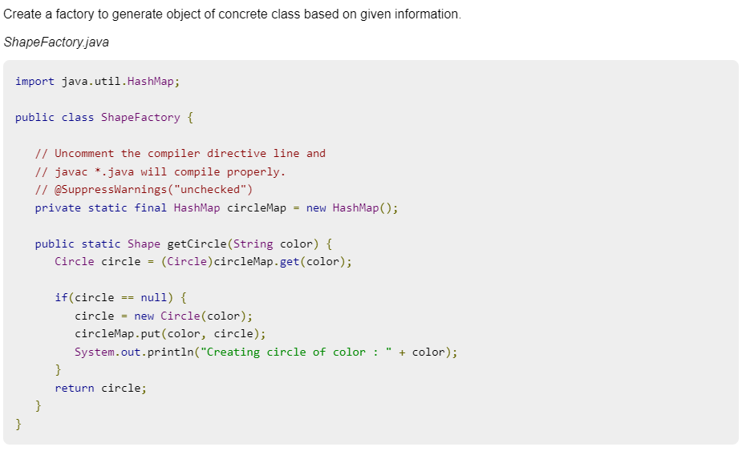

Slide 8
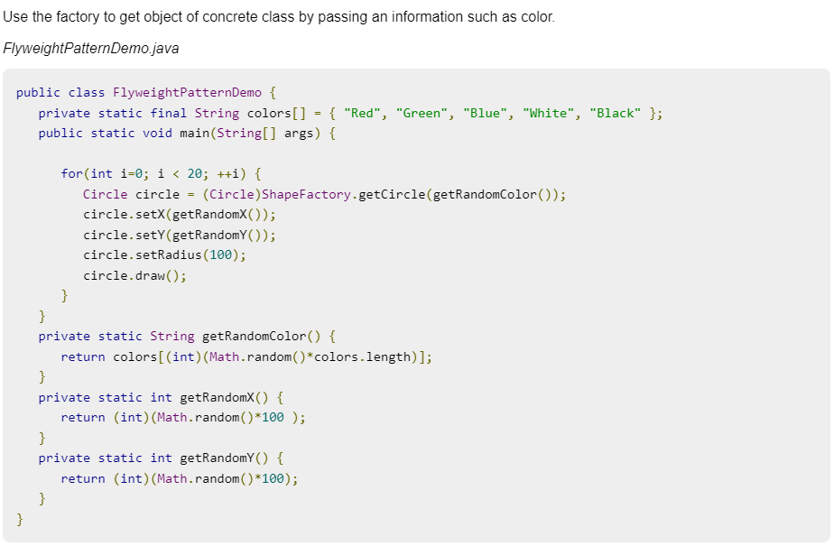

Slide 9
